Slide 1

Introduction to computers
29.10.2020

Slide 2
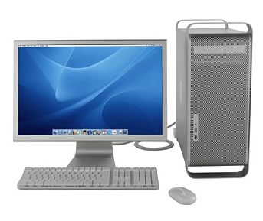
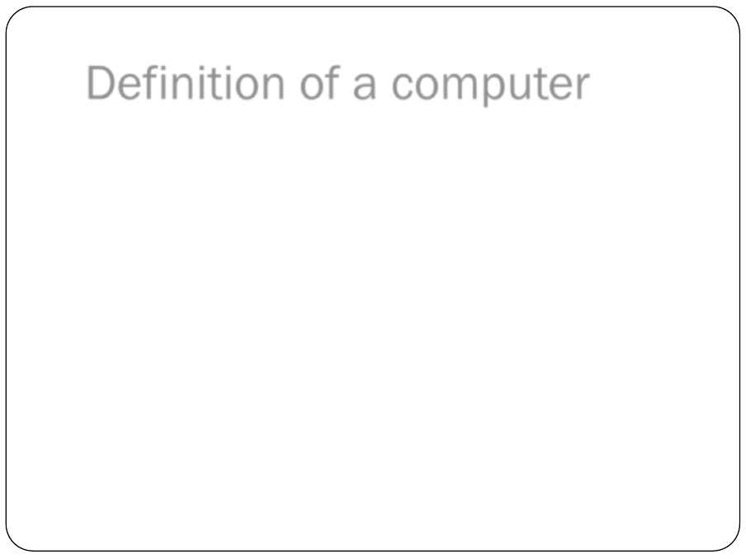
Definition of a computer
Definition of a computer
Introduction to Computers
3

Bydefinition,acomputerisan
electronicdevice
thatinputsdata,processesdata(convertingitintoinformationthatisusefultopeople)outputsandstoresinformation.

Computersarecontrolledbyprogrammedinstructionsthattransformthedataintomeaningfulinformation.

GenerallyaComputerisa
device
thataccepts
input
,
processes
it,
stores
data,andproduces
output
.
Definition of a computer
Introduction to Computers
3

Bydefinition,acomputerisan
electronicdevice
thatinputsdata,processesdata(convertingitintoinformationthatisusefultopeople)outputsandstoresinformation.

Computersarecontrolledbyprogrammedinstructionsthattransformthedataintomeaningfulinformation.

GenerallyaComputerisa
device
thataccepts
input
,
processes
it,
stores
data,andproduces
output
.
Computer is an electronic device that accepts input , processes it, stores data, and produces output .

Slide 3
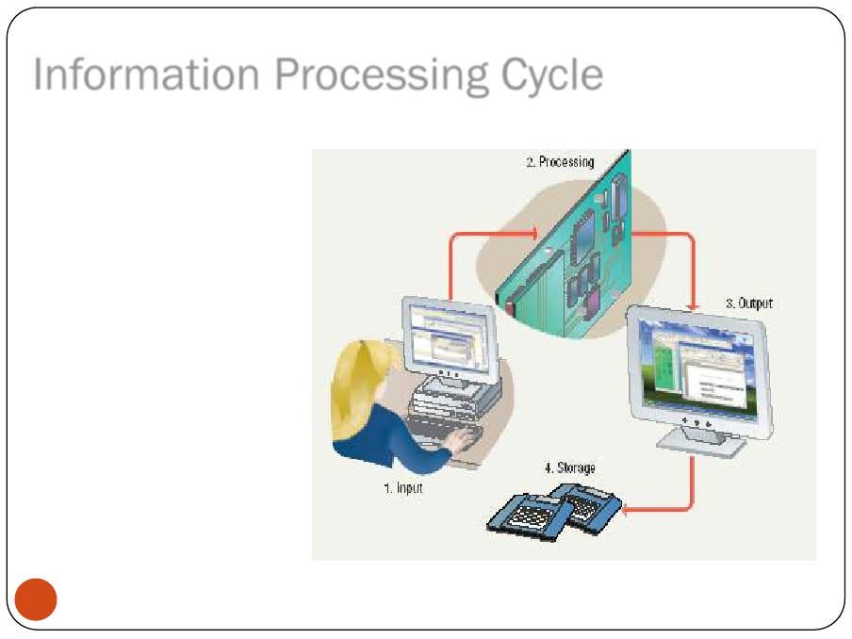
Information Processing Cycle
Steps followed to process data :
Input
Processing
Output
Storage

Slide 4
Information Processing Cycle
Input :
Information provided to the computer by a person, the environment, or another computer.
Examples of Input
words and symbols
numbers
pictures
audio signals from a microphone
signals from another computer
temperature, speed, pressures, etc. from sensors

Slide 5
Information Processing Cycle
Processing - manipulation of data.
Data are symbols that represent raw facts, objects,and ideas about people,
places, events, and things that are of importance in an organization.
A computer program or software is a series of instructions that tell a
computer how to carry out a processing task.
Examples of Processing :
Arithmetic calculations
Sorting a list
Modifying pictures
Drawing graphs

Slide 6
Information Processing Cycle
Output :
The result produced by a computer after processing the data.
Output device:
displays, prints, or transmits the results after processing.
Examples of Output
images on a monitor
printed documents
sounds
signals to device controllers

Slide 7
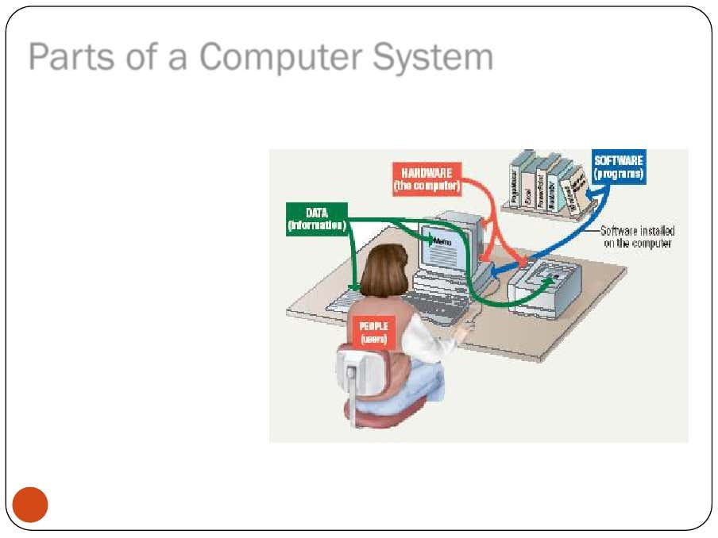
Parts of a Computer System
Computer systems have four parts :
Hardware
Software
Data
User (people)

Slide 8
Parts of a Computer System
Hardware : tangible parts of a computer.
It is a mechanical devices that make up the computer.
Hardware Components :
Monitor , Floppy Disk , CD ROM Drive , Hard disk drive , keyboard ,
Mouse , modem , sound cards , CD writers , Printers
A computer’s hardware devices falls into one of the four categories;
Processor , Memory , Input and Output , Storage

Slide 9
Parts of a Computer System
Processor : Central Processing Unit – Brain of the computer.
Memory :
RAM (Random Access Memory) – Volatile – Information is lost when
power is off.
ROM ( Read Only Memory) – Non Volatile memory
Input and Output : mouse , keyboard , Scanner , Printer,
Monitor etc
Storage :
CD , DVD , Hard disk drive etc

Slide 10
Parts of a Computer System
Computer Software :
Software is the set of instructions that makes the computer to perform tasks.
Set of Instructions : Program
The software is all the programming that makes the computer run and controlling everything that the computer does.
For any computer to function, it needs to have software installed on it.

Slide 11
Parts of a Computer System
Software Types :
System Software : Software created by computer system. It is needed to run a computer efficiently.
3 basic types of system software are :
Operating system :
The OS tells the computer how to interact with the user and its own devices.
Examples of operating systems: Windows, Macintosh operating system and Linux.

Slide 12
Parts of a Computer System
A network operating system :
allows computers to communicate and share data across a network.
Ex : Windows server 2003
A utility is a program that makes the computer system easier to use or performs highly specialized functions.
Ex : Antivirus , Partition Magic
Application Software: Software created by user
Tells the computer how to accomplish specific tasks, such as word processing or drawing, for the user.

Slide 13
Parts of a Computer System
Data:
Data consists of raw facts, which the computer can manipulate and process into information that is useful to people.
Users:
People operating the computer.
Tell the computer what to do.

Slide 14
Information storage
1 bit
8 bits
16 bits
32 bits
64 bits
bit (1 or 0)
byte (octet) (2⁸)
word (2¹⁶)
double (2³²)
long double (2⁶⁴)
Encoding information on a fixed element of length n with a base b gives b^{n} non-redundant possibilities

Slide 15
Information coding
Binary
  0 or 1
Octal
  0-7
Hexadecimal
  0-9+A-F
Decimal
  0-9
How to count
128+32+16+4+1=
  181 (decimal)
  265 (octal)
  B5 (hexadecimal)
Signed vs unsigned
  0 to 255
  -127 to +127
128 64 32 16 8 4 2 1
1 0 1 1 0 1 0 1

Slide 16
Operations on bits
Booleans:
  0 = false = no
  1 = true = yes
Operators:
  AND
  OR
  XOR
  NOT
Example tables
AND | 0 | 1
0 | 0 | 0
1 | 0 | 1
OR | 0 | 1
0 | 0 | 1
1 | 1 | 1
XOR | 0 | 1
0 | 0 | 1
1 | 1 | 0

Slide 17
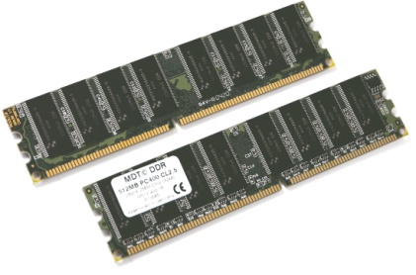
RAM/ROM
Memory mapping
Address Values
0000
0001
0002
..
..
..
..
FFFF
Size reminder:
Kilobyte Kb 2¹⁰ ~10³
Megabyte Mb 2²⁰ ~10⁶
Gigabyte Gb 2³⁰ ~10⁹
Terabyte Tb 2⁴⁰ ~10¹²
Petabyte Pb 2⁵⁰ ~10¹⁵
…
1 0 1 1 1 0 0 1
0 0 0 0 1 1 1 1
1 1 1 0 0 0 1 1
0 0 1 0 0 1 0 0

Slide 18
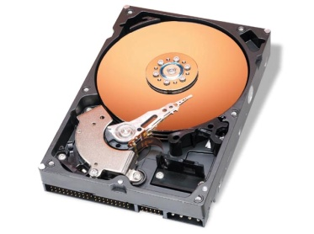
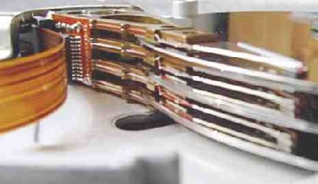
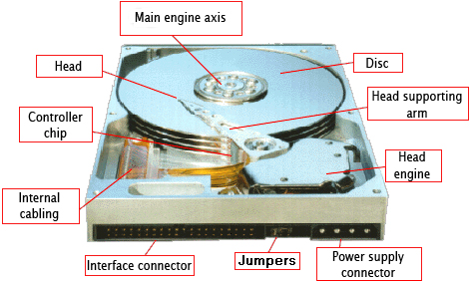
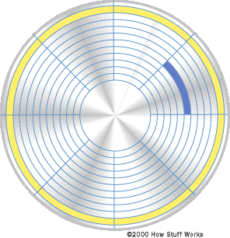
HD/DVD
track
sector
head

Slide 19
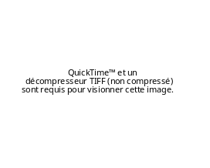

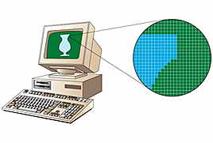
Display
Screen pixel or dots
Color coding: 32 bits
1 pixel = 3 bytes of color (RGB)+1 byte alpha channel (transparency)
1600x1200x4bytes=7,5 Mb!
Fonts
  Bitmap
  Vectors
    TrueType, OpenType, PostScript

Slide 20
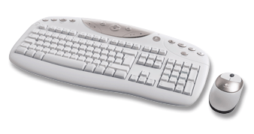
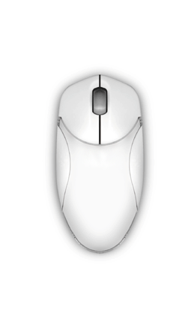
Keyboard/Mouse
Each key (or combination of keys) of the keyboard sends a code to the computer.
The code is interpreted and converted to the corresponding ASCII or Unicode number.
The mouse movements
  1 to 4 bytes (vertical & horizontal)
Buttons
  Clicked, pressed, rolled
buttons

Slide 21
Software layers
Files
Data (.doc, .mp3)
Software
Word, scripts, mail, web browser…
User Interface
Quartz
CLI, X-Windows
Windows
Operating System
MacOSX
Linux
Windows
ROM
Firmware
BIOS
Hardware
CPU, RAM, HD, DVD

Slide 22
File systems
What exactly is a file?
  a piece of information (text, graphic, data, music program, script)
  it is identified by a name and an logical address (or path)
  other informations: date, size, type, creator, ownership, physical address…

Slide 23
File system organisation
Disk 1
Disk 2
Disk 2
C:
D:
/
DOCS
PROGS
CONFIG
DATA
Directories
/usr
/home
Disk 1
WORD
EXCEL
EXPT1
EXPT2
Subdirectories
local
phil
john
bin
lib
emacs
X11
Windows
Unix

Slide 24
Path
The path is the logical address used by the system or the user to locate a file.
Example:
/bd_du_Palais/35/etage/4/appart/12/Dupont_ Jean.txt
suffix
filename
path

Slide 25
File types
Executable
  .exe
  .app
  Unix requires « x »
Data
  Text (.txt)
  Music (.mp3)
  Image (.jpg, .gif)
  Movie (.mpg, .mov)
  Binary (.bin)
Special cases in Unix
  STDIN
  STDOUT
  STDERR

Slide 26
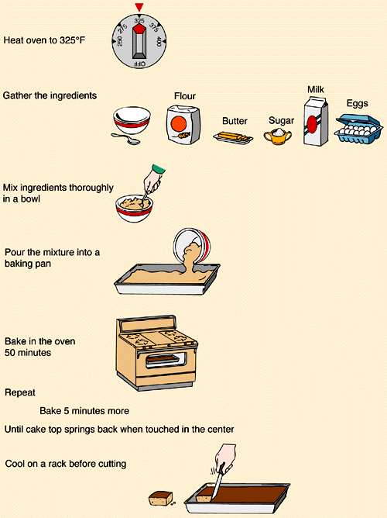
What is a program?
Set of Instruction.
Algorithm :
step by step procedure to
solve a problem.

Slide 27
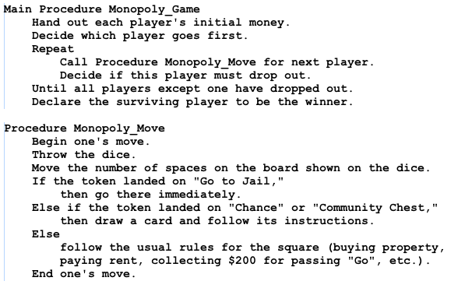
Pseudocode
It’s simply an implementation of an algorithm in the form of annotations and informative text written in plain English. It has no syntax like any of the programming language and thus can’t be compiled or interpreted by the computer.

Slide 28
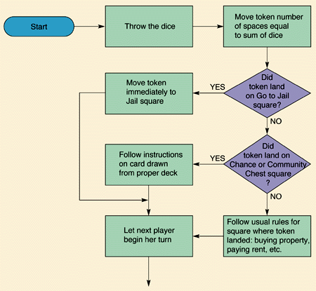
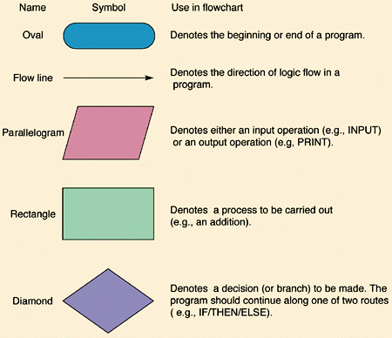
Flowcharts

Slide 29
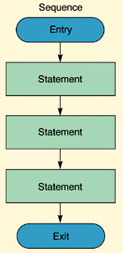
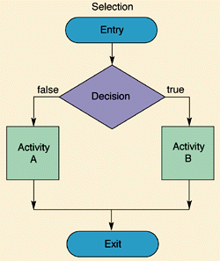
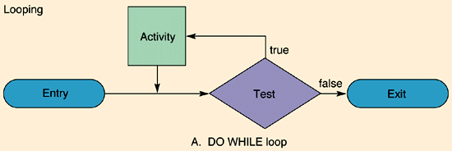
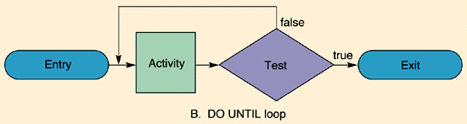
Flowcharts details

Slide 30
Languages
Low level (processor dependent)
  Machine code, assembler
High level: structured, procedural
  Fortran, C, Pascal…
High level: object oriented
  C++, Java, C#, Perl, Objective-C…
Virtual machines
  Java, C#…
Scripting
  Perl, Python, JavaScript…

Slide 31
Source code -> Object code
Compiler+linker
  Fortran, C, Pascal, C++…
Interpreter
  Basic, Perl…
Intermediate
  Java
Compiler+linker
  Fast to execute, but slow to debug
Interpreter
  Slow to execute, but fast to debug (no need to recompile)
Intermediate
  Slow…

Slide 32
Source code
Loops
  Allow the computer to repeat blocks
Tests
  Decide what to do
Subroutines
  Programs frequently called (functions)
Comments
  The most important lines of the source code…
Pointers
  Reference to region in memory (address)
Objects
  Combination of data and code

